Slide 1
Astragalus
von den Driesch 1976
Wolverton 2007

Slide 2
Calcaneus
Bc
Dc
Medio-lateral
Cranio-caudal
von den Driesch 1976
Purdue 1987
Cantryll 2017

Slide 3
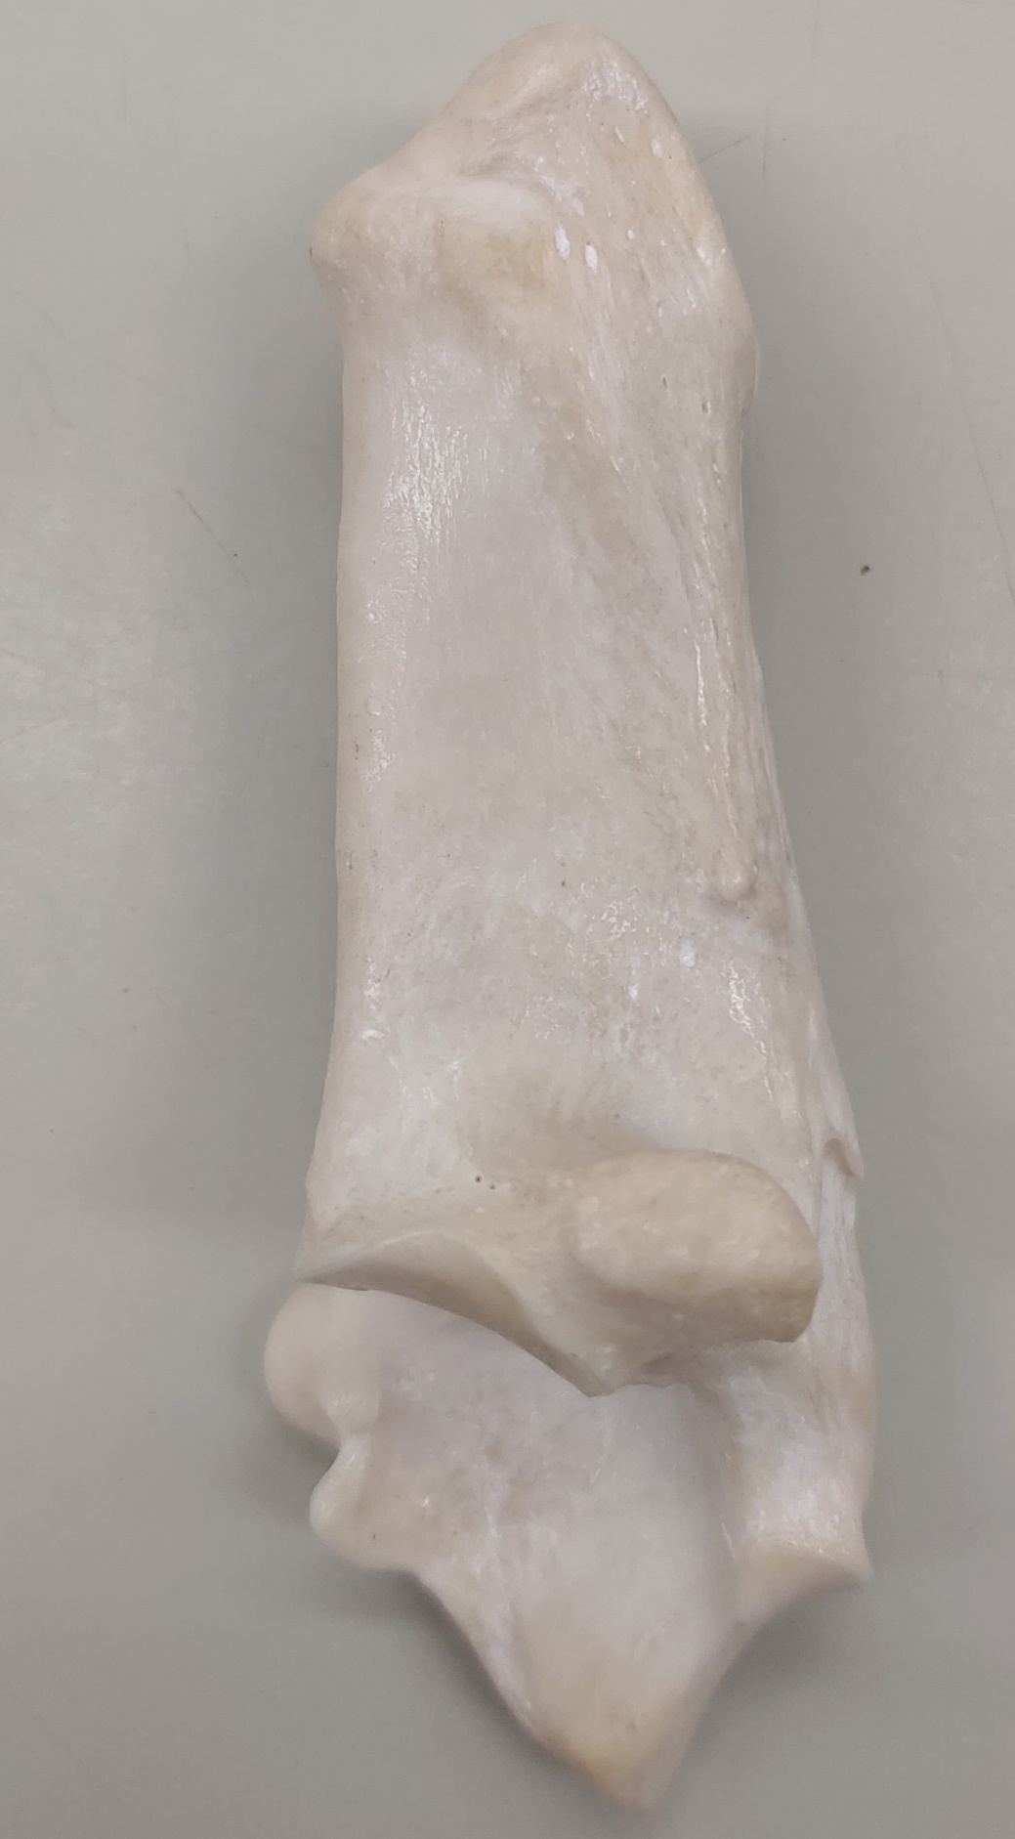
Calcaneus
Dc?
Bc
Dc
Medio-lateral
Cranio-caudal

Slide 4
Tibia
Dp in diagonal view
Cantryll 2017
von den Driesch 1976

